Slide 1

Skill 17
Web Development

Slide 2




Who are we
Cyril Wanner
https://www.linkedin.com/in/cyrilwanner/
Sebastian Häni
https://www.linkedin.com/in/sebastian-haeni/

Slide 3
Theme
Let's introduce this year's test project theme.

Slide 4

Notes:
AI, especially Generative AI, is taking of in its capabilities and with that its popularity.
I am sure some of you have tried such tools themselves.
Show of hands:
Who of you has tried ChatGPT or a similar service?
Who of you has tried to generate images using Midjourney, Dall-E or a similar service?
Who of you have tried Github Copilot or a similar service?
This image was generated with midjourney as an example of generative AI. Anyone wants to guess the prompt (reverse prompting)?
The prompt was: web developers competing against each other from different nations in poland gdansk

Slide 5
Module Overview
 | C1 | C2 | C3
Morning | Module A Static Website Design 3h | Module C Backend API 3h | Module E Advanced Web Development 3h
Afternoon | Module B Backend SSR 4h | Module D Frontend 4h | Module F Collaborative Challenge 2h
Notes:
Module A: Implement a static website for a client. Competitors are given structure, breaktpoints. No render frameworks allowed!
Module B: Implement a backend with a database. The backend renders HTML pages.
Module C: Implement a backend which provides a REST API. The solution of module B will be provided (backend & database dump). Competitors have to extend the provided database.
Module D: Implement a frontend which consumes the REST API from Module C. The solution of module C will be provided.
Module E: Competitors will receive 3 separate tasks which all involve using native and advanced Web features that the browser provides. Frameworks will not be used.
Module F: Competitors form groups and collaboratively work on a creative idea and then present it to the other groups.

Slide 6
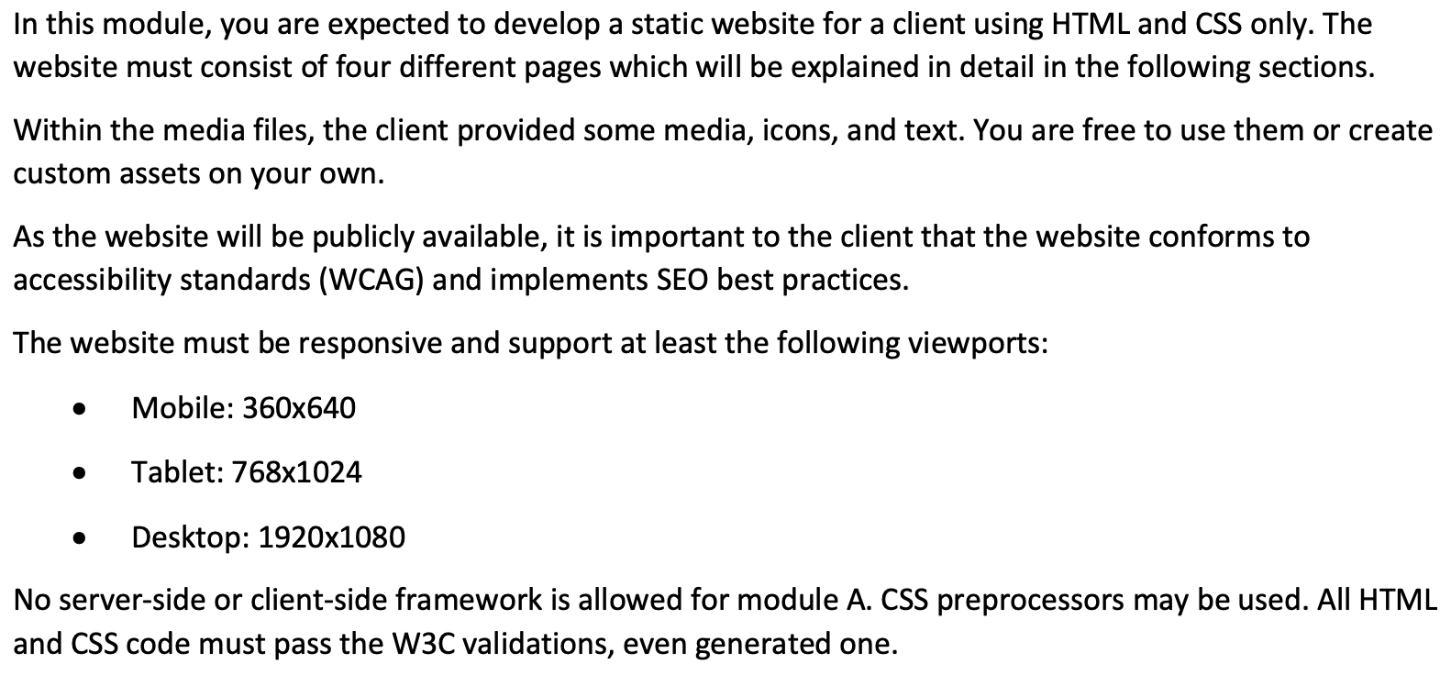
Module A

Slide 7
Module A - Use of Frameworks
This module is restricted to HTML/CSS or anything which creates static HTML/CSS assets during build time, which still pass W3C validators.
The experts shall assess statically served assets. No client or server side code shall run to generate the website on request.
In that sense, Javascript is not allowed to be included in the assets.
Also in that sense, Tailwind can be used.

Slide 8
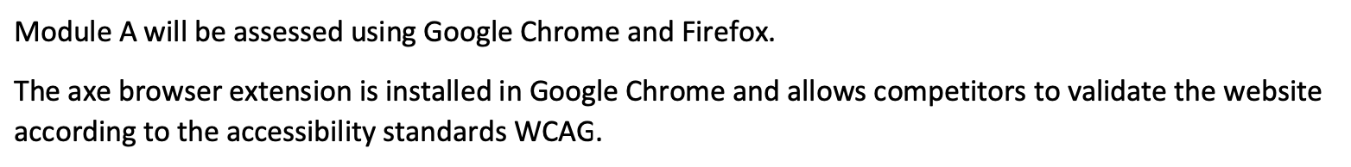
Module A - Competitor Information

Slide 9
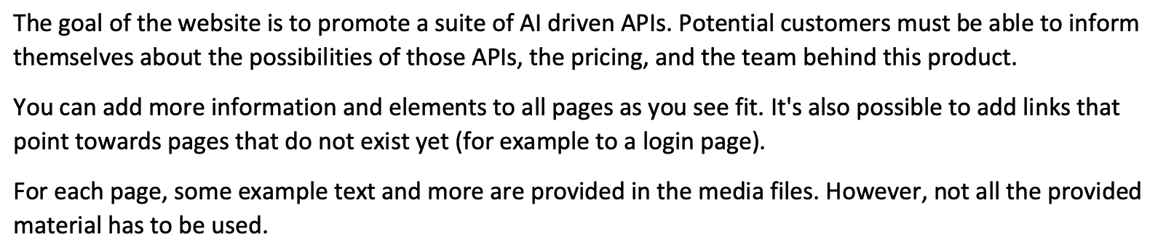
Module A - Website Requirements

Slide 10
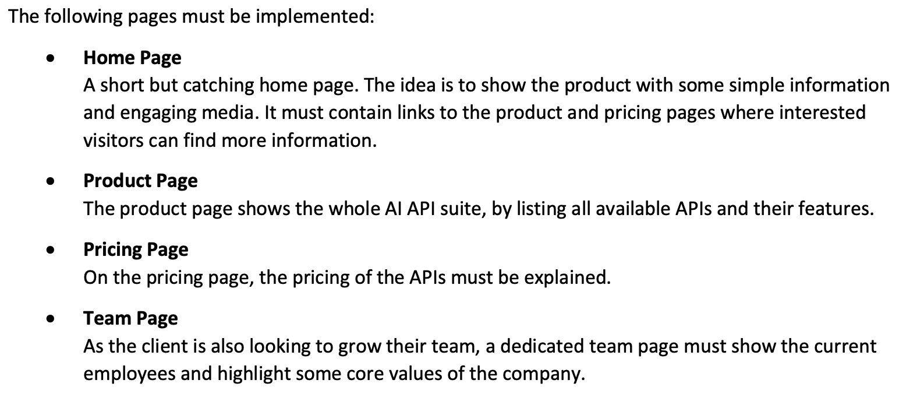
Module A - Website Requirements

Slide 11
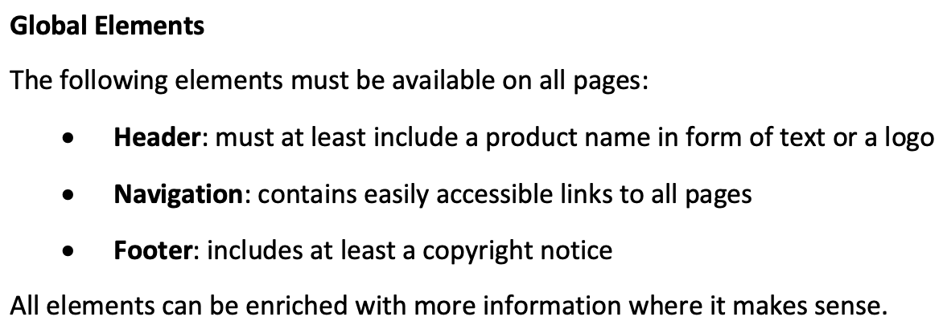
Module A - Website Requirements

Slide 12


